Slide 1
My Health Keeper
1
Team Aide
Siana Rizwan (180042105)
Farzana Tabassum (180042119)
Sabrina Islam (180042122)

Slide 2
My Health Keeper is a ONE STOP solution where users can store all sorts of health related information in ONE place
2

Slide 3
Features At A Glance…..
Storing General Health Information
Diet Plan
Storing Specialized Health Information
Report Analysis
Disease Prediction
Medicine Reminder
Menstrual Cycle Tracker

Slide 4
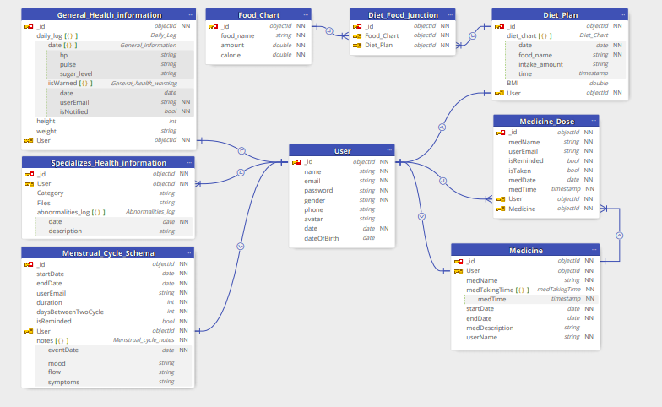
ER-Diagram
4

Slide 5
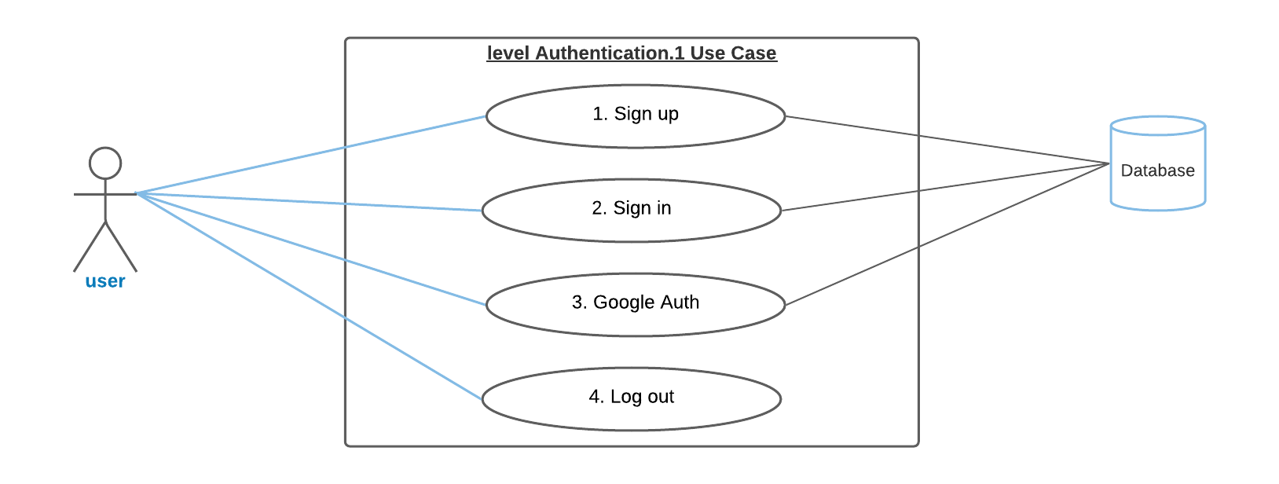
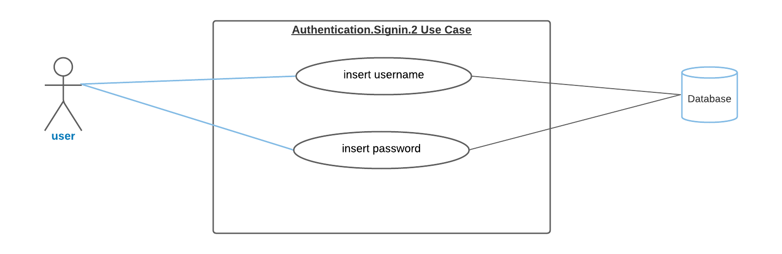
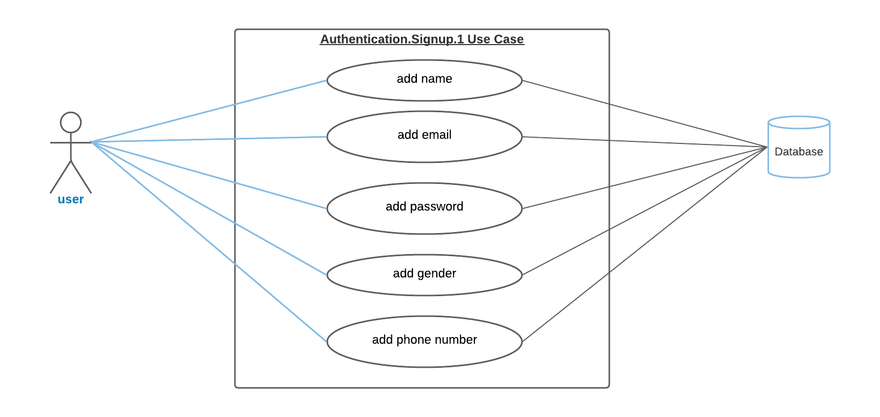
Use Case (Level 1)
5

Slide 6
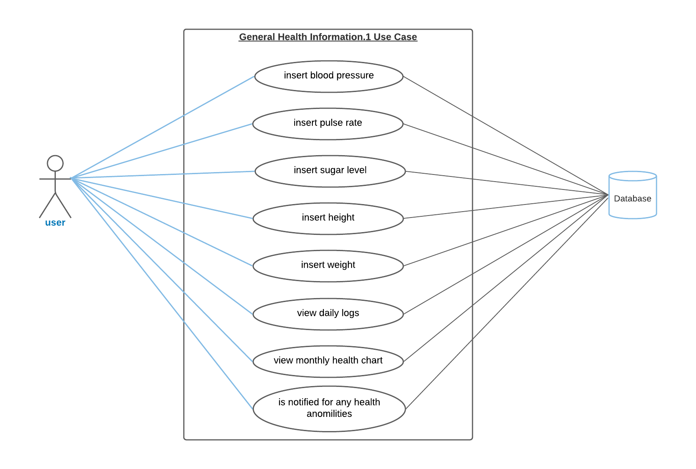
Use Case (Level 1)
6

Slide 7
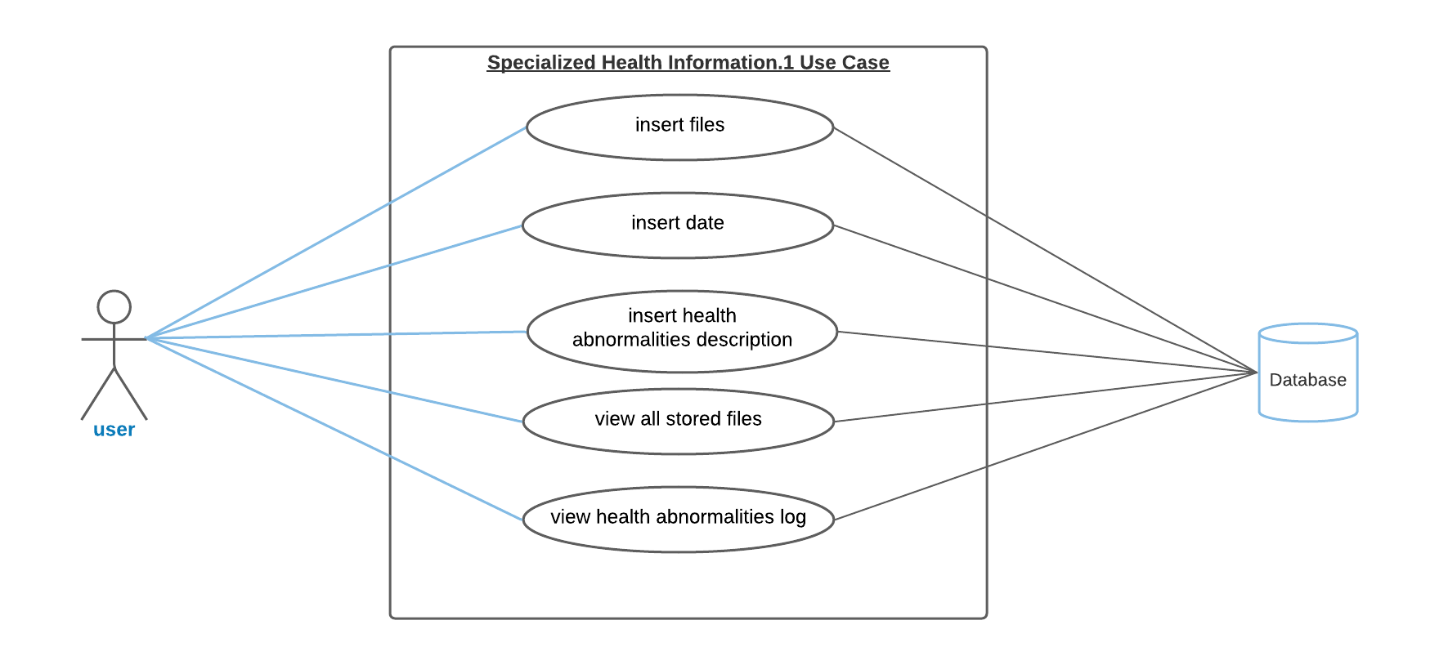
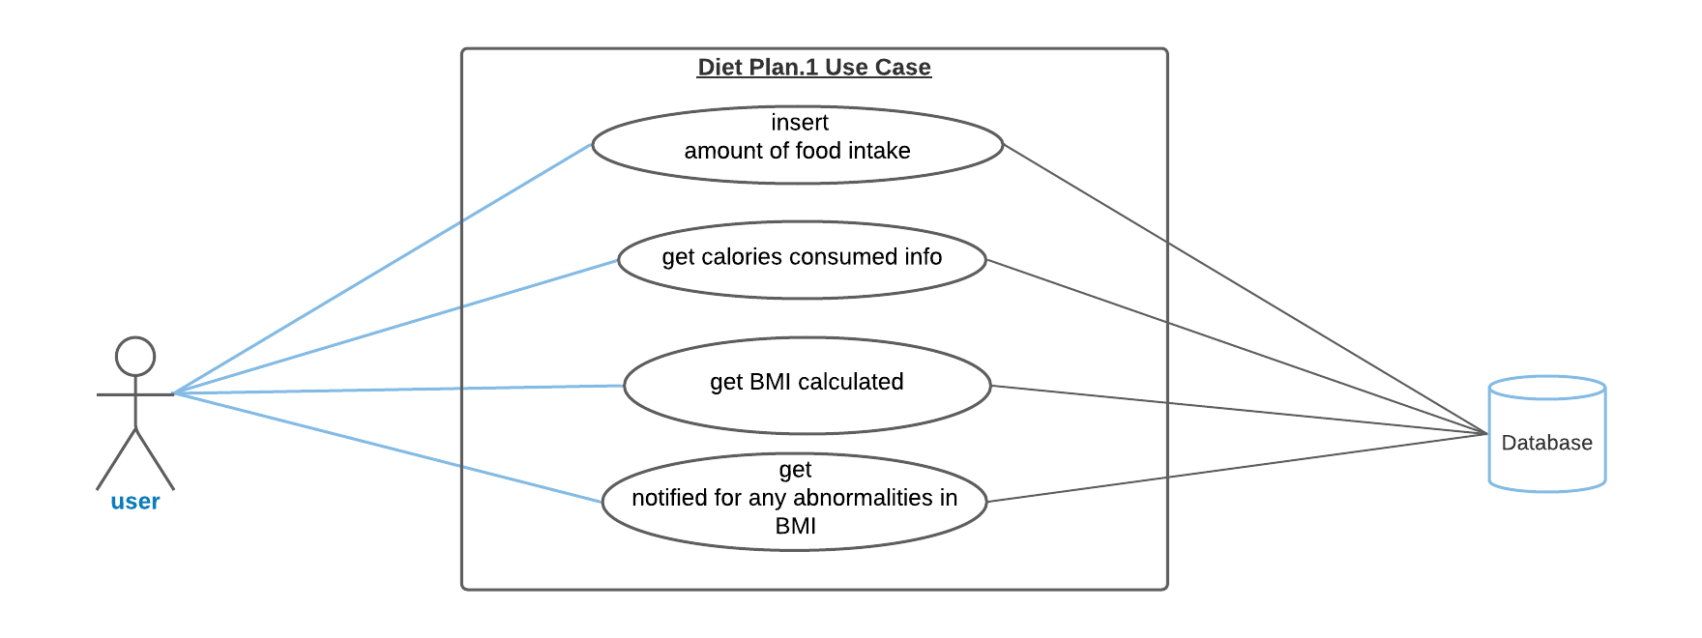
Use Case (Level 1)
7

Slide 8
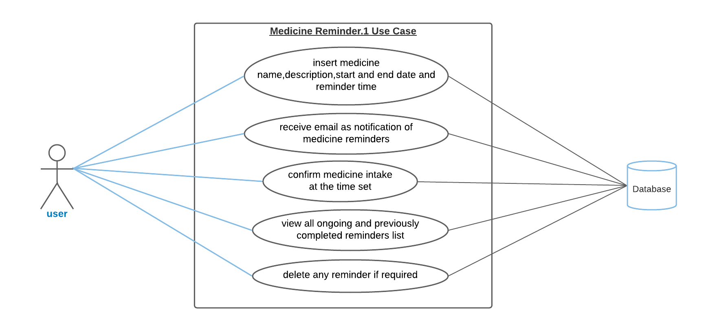
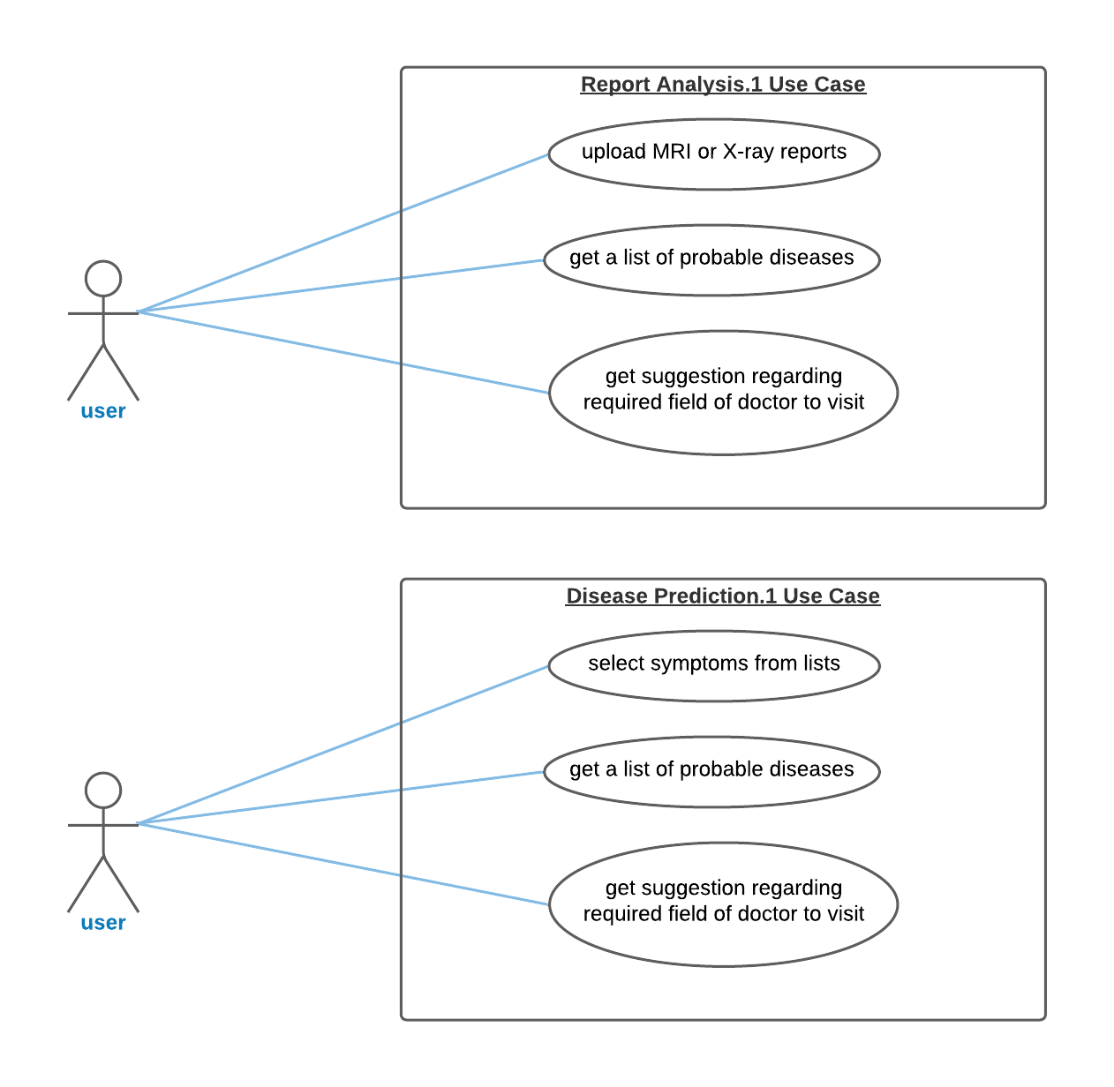
Use Case (Level 1)
8

Slide 9
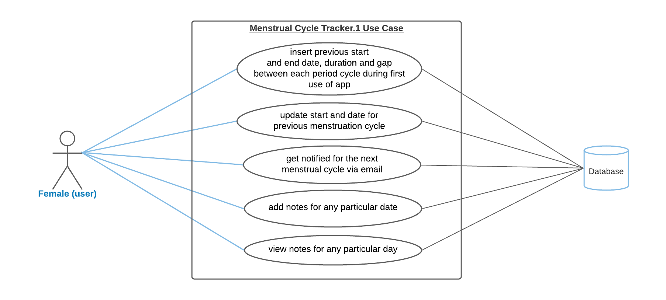
Use Case (Level 1)
9

Slide 10
Features Completed
10
Before Progress Presentation
After Progress Presentation
Authentication
Medicine Reminder
Menstrual Cycle Tracker
Started working on Storing General Health Information
Storing General Health Information (completed)
Diet Plan
Storing Specialized Health Journal
Report Analysis
Disease Prediction
UI modification and testing

Slide 11
The floor is open for Q/A
11
Thank You!

